Slide 1
Error 404
Physics Project

Slide 2
OUR TEAM
Stefan Hristov
Scrum Trainer
Maxim Marinov
Back End Developer
Mihail Petrov
Back End Developer
Hristiyan Petrov
QA engineer

Slide 3
The Ideа
We wanted to create a helpful user-friendly application that would also provide knowledge and entertainment.
In our collaborative work we created a calculator based on physics formulas and two games that implement movement and collision.

Slide 4








Technologies we used!

Slide 5
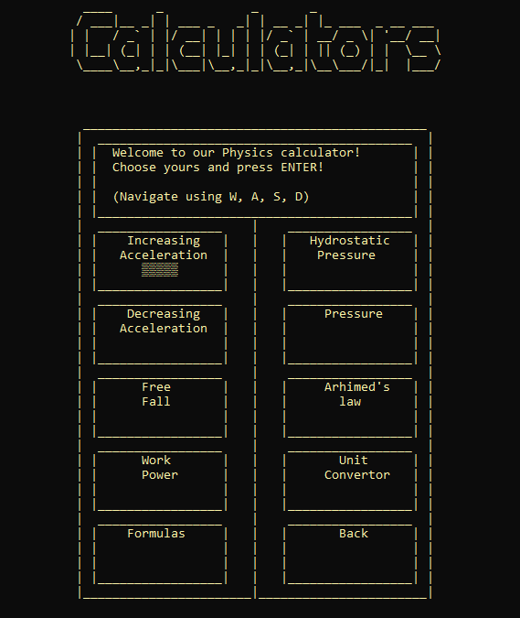
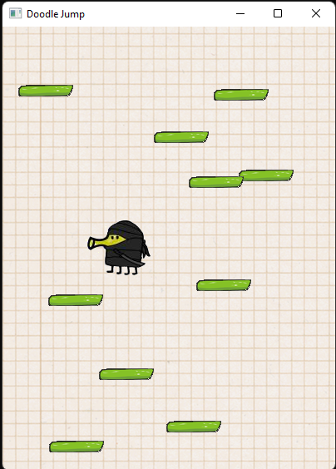
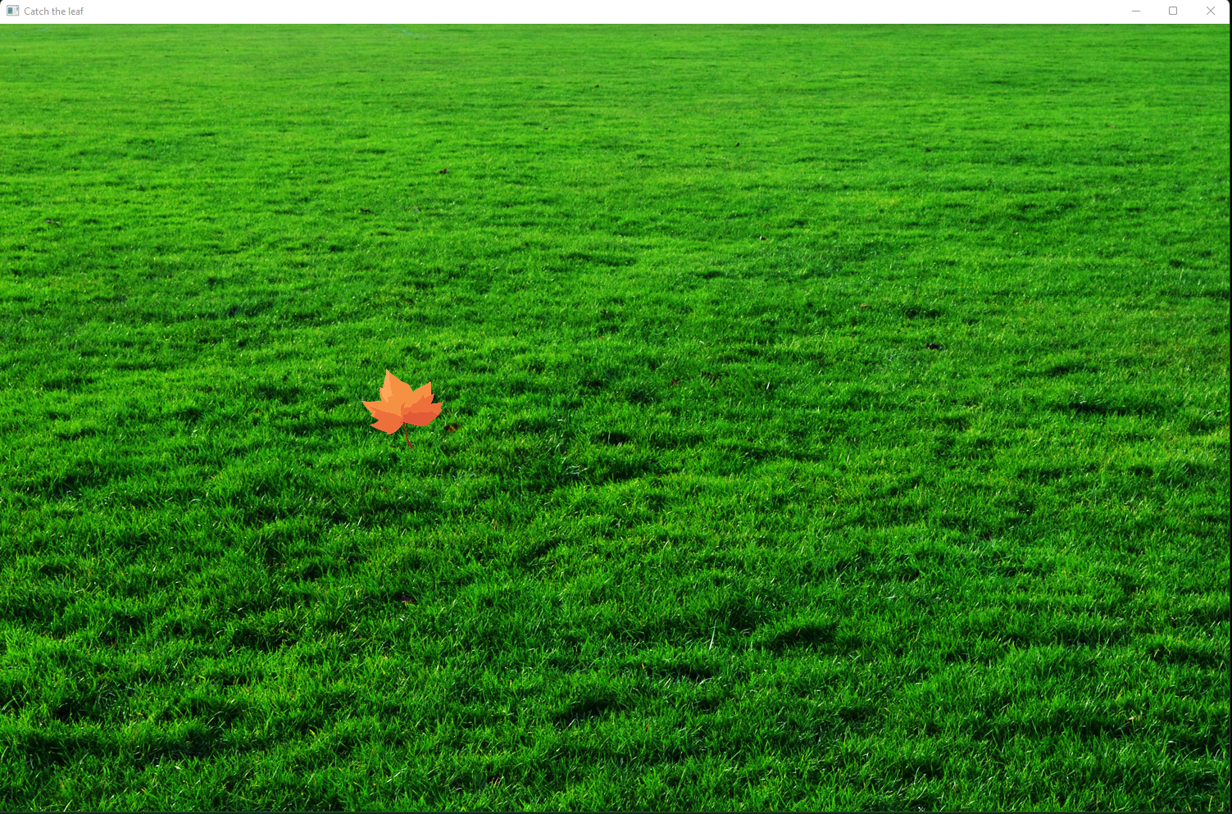
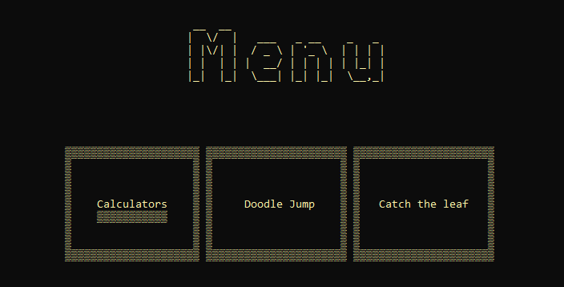
Parts of our project

Slide 6
Now let’s continue with the application!

